Slide 1



SUMMER TRAINING
MongoDB
Modern Data Management for Developers
National Telecommunication Institute
Ministry of Communications and Information Technology

Slide 2



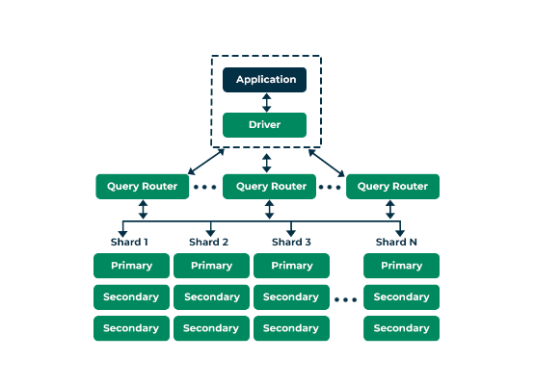
COURSE ROADMAP
01. Introduction to NoSQL
02. Getting Started with MongoDB
03. Download & Setup MongoDB Server & Shell
04. CRUD Operations

Slide 3
Section 01
Introduction to NoSQL Databases

Slide 4

WHAT IS NOSQL?
"Not Only SQL"
NoSQL databases are non-relational systems designed to handle vast amounts of data, high user loads, and frequent data structure changes.
Schema-Free Design
Horizontal Scalability
Unlike relational tables, NoSQL allows storing data without a predefined, rigid structure. Perfect for evolving applications.
Instead of buying bigger servers (Scale-Up), we just add more cheap servers to the cluster (Scale-Out).

Slide 5

WHY USE NOSQL?
Handling Modern Data
•
Semi-Structured: Data with metadata (JSON, XML).
Example: Social Media Profile
•
Unstructured: Media files, logs, social feeds.
{ "name": "Ahmed", "bio": "Developer...", "skills": ["Java", "MongoDB"], "metadata": { "last_login": "2023-10-01" } }
•
Real-Time: Instant data processing for apps.
Instructor Note: Real-world apps like Netflix and Uber rely on NoSQL for speed and scalability.

Slide 6






TYPES OF NOSQL DATABASES
Key-Value
Wide Column
Graph Store
Simple pairs. High speed for caching.
Data stored in dynamic columns.
Focuses on relationships (nodes/edges).
Cassandra
Redis
Neo4j

Slide 7
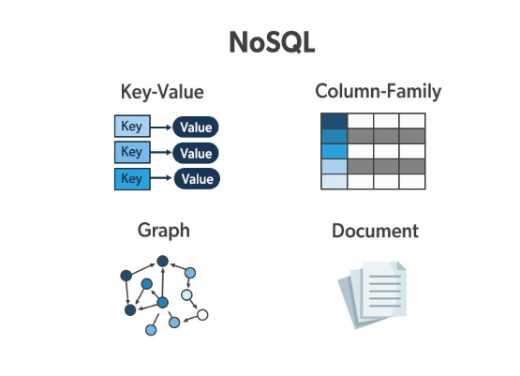

THE DOCUMENT STORE
MongoDB
The world's most popular document store.
•
Stores data in JSON-like documents.
•
Fields can vary from document to document.
•
Highly intuitive for developers.

Slide 8

WHAT IS MONGODB?
#1
OSS
JSON
Document Database
Open Source & Community
Developer Friendly
MongoDB is a cross-platform, document-oriented database that provides high performance, high availability, and easy scalability.

Slide 9
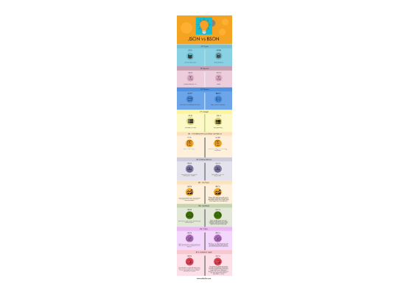
BSON: THE ENGINE OF MONGODB
Binary JSON
MongoDB stores data in BSON format. It's a binary representation of JSON-like documents.
•
Faster: Traversing binary data is quicker.
•
More Data Types: Supports Date, Binary, ObjectId, etc.
•
Space Efficient: Optimized for storage and scans.

Slide 10






DATA HIERARCHY
Database
Collection
Document
A container for collections. Like a SQL DB.
A group of documents. Like a SQL Table.
A record in a collection. Like a SQL Row.
Example Document:

Slide 11





INSTALLATION & SETUP
Quick Verification
Open your terminal and type:
Install Community Server
This confirms the server is running and your shell can communicate with it.
Install Mongosh (Shell)
Connect to localhost:27017

Slide 12






IMAGE SOURCES
https://www.nti.sci.eg/images/logo.png
Source: www.nti.sci.eg
https://media.geeksforgeeks.org/wp-content/uploads/20231107111719/MongoDB-Architecture.png
Source: www.geeksforgeeks.org
https://miro.medium.com/0*jThgXou1RZ6hPiq6.jpg
Source: coderiksenthil.medium.com
https://cdn.educba.com/academy/wp-content/uploads/2018/11/JSON-vs-BSON.jpg
Source: www.educba.com
https://media.geeksforgeeks.org/wp-content/uploads/20220523175518/CRUDOperations.png
Source: www.geeksforgeeks.org
https://marionoioso.com/wp-content/uploads/2026/02/MongoDB-Data-Modeling-The-Truth-About-Relationships-Data-Duplication-and-Performance.jpg
Source: marionoioso.com

Slide 13



IMAGE SOURCES
https://cdn.prod.website-files.com/6717800cb1e973b8fc433b03/6717800cb1e973b8fc434341_670199f49cd01719054e968c_T8LWGtLjMYc0avFy.gif
Source: www.mydbops.com
https://i.sstatic.net/m2tBs.png
Source: stackoverflow.com
https://www.scaler.com/topics/images/mongodb-restore-command_thumbnail.webp
Source: www.scaler.com

